Slide 1
Processes and Devices
Notes:
A Biological Process is another one of these hard-to-define-precisely terms. Examples include biosynthetic pathways, translation, transcription, and replication, and secretion.

Slide 2
The GO Biological Process definition:
“A biological process is a recognized series of events or molecular functions. A process is a collection of molecular events with a defined beginning and end. Mutant phenotypes often reflect disruptions in biological processes.”
http://www.geneontology.org/GO.process.guidelines.shtml
Notes:
The Gene Ontology folks define it as a recognized series of events or molecular functions, with a defined beginning and end.

Slide 3
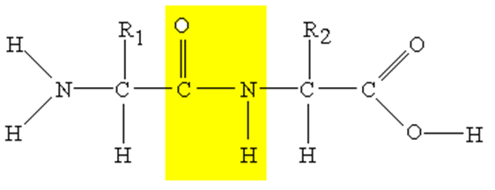
Back to the Mealy machine
SAR Constraints
P
S
Mechanistic Constraints
State 0
State 1
State 2
E
E
E
S
P
Notes:
Let’s examine this concept as it applies to a biosynthetic pathway through our state machine representation. Remember that we can model an enzyme in terms of a Mealy machine composed of the various microstates that the enzyme participates in. The transitions between these states can have inputs and outputs, and the scope of those inputs and outputs can be captured as constraints.
*
We can model the constraints defining the transition between the ES and EP states by organic mechanistic constraints that define the molecular requirements for doing the chemical conversion.
*
For example, a protease may recognize various molecules that look like this dipeptide, but many different R groups would also be good substrates, and presumably this amine on the far left of the molecule isn’t necessary for the chemistry to happen. From an organic chemistry perspective, all that matters in this molecule for the hydolysis reactions to occur is the C-double-bond-O-dash-NH portion in the middle. That set of atoms represents the mechanistic constraints that all substrates must have to undergo this state conversion.
*
The other two transitions between these states are non-covalent interactions. They correspond to the enzyme’s ability to hold onto the molecule, which is a property of the molecule’s overall shape and the types of functional groups present. It reflects the shape of the active site of the enzyme in relation to the atoms that undergo chemistry.
*
In our dipeptide example, it corresponds to the encapsulation of what types of R groups will be tolerated and their positioning relative to other atoms in the molecules. This type of model is generally referred to as a structure activity relationship, or SAR model.

Slide 4
Two enzymes passing an intermediate
E1
E1
E2
P
A B C
S
E1
E1
E1
If the constraints around E1’s P overlap the SAR constraints around E2’s S, then there is an inferred pathway to funnel substrates between these pathways.
If P_{E1} matches the SAR constraints of S_{E2}, but not its mechanistic constraints, then it is a competitive inhibitor
S
P
E2
P
S
E2
E2
E2
S
P
E1
E2
Notes:
Suppose we have two enzymes E1 and E2, and we want to know if these two enzymes represent a process or not. For there to be a process involving both enzymes, then *click* one of the outputs of E1 must be an input to E2. For this condition to be met, some molecule P1 must satisfy the constraints of E1’s transitions, and also satisfy the SAR constraints for binding to E2. If this condition is met, then *click* this reaction sequence of A to B to C involving E1 and E2 could occur. *click* If the product of E1 matches the SAR constraints for substrate binding of E2, but that molecule does not satisfy the mechanistic constraints, then it is a competitive inhibitor of E2. Genetically, we would express that by saying that the *click* E1 represses E2. If no SAR constraints match, these enzymes are orthogonal to one another

Slide 5
What then is the process?
E1
E1
E1
A
B
A
B
C
E2
E2
E2
B
C
Notes:
If we combine these two enzymes in an aliquot of liquid and feed them substrate A, the overall system now has 9 different species. This combination of molecules can now be referred to as a process. We could define that process by the set of molecular functions, which would be the set of molecular models for E1 and E2, or we could express it as the pathway from A to B to C. When a pathway is expressed in the cell, the interactions that are observed become concrete. Either there is some specific molecule A in the cell that undergoes this pathway, or nothing happens. However, in another cell a different molecule could satisfy the role of A as long as it satisfies the SAR and mechanistic constraints for the enzymes in the process. Thus, once we define the genetic composition of a cell, the distinction between the set of molecular functions and the pathways observed is irrelevent. They correspond to the same chain of events. However, in synthetic biology we are adding foreign genes to a cell, and there is no guarantee that that the same cohort of substrates will interact with these enzymes as did in the source organism.

Slide 6
What then is the process?
E1
E1
E1
A
B
A
B
C
E2
E2
E2
B
C
Notes:
For example, other enzymes in the chassis organism may generate other molecules that satisfy some of constraints for the enzymes. If those molecules satisfy all the constraints, then a side reaction is observed. If they match SAR constraints but not some mechanistic ones, then they could inhibit the pathway. Thus, when we introduce a series of genes that performs a function in one cell to another cell it is not necessarily the case that the same process results. Additional interactions may be taking place that complicate things.

Slide 7
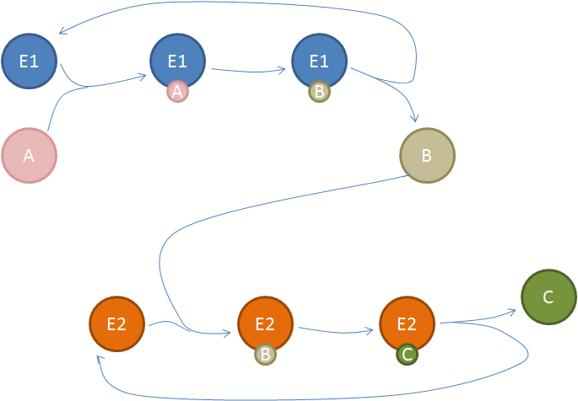
A Device
P_{J23100}
Ec_e1
Ec_e2
Notes:
The term ‘device’ in synthetic biology refers to an isolated subset of genes that together encode a process. A ‘Device’ refers to either the process in its entirety or just the genetically-encodable portions such as RNA and protein coding sequences. You can encode a device in DNA by creating a ‘Part’ which in this case would involve a promoter and two open reading frames. There is a fair amount of debate about the definition of a device in synthetic biology just as there is a debate about what is a Part. The different definitions all amount to different levels of abstraction. For example, does the definition of the device include the RBS or not, and does it correspond to a specific protein sequence or just the molecular function of the enzymes involved. The jist of all definitions deals with some process that is encoded in a DNA, but the most useful abstraction for engineering is not yet fully defined.

Slide 8
A device
E1
E1
E1
A
B
A
B
C
E2
E2
E2
B
C
Notes:
When you transfer a device to another cell, assuming all the enzymes still get expressed and folded, and all the native inputs are provided, then the full set of molecular interactions should be preserved and the process will still occur. However, additional reactions will also occur, and could have the effect of creating alternate products or interfering with the process encoded by the device. In this discussion, I have spoken specifically about biosynthetic pathways with chemical inputs. However, as drawn and formalized as state machines, there is no requirement that these inputs are small molecules. They could be proteins, RNAs, or DNAs too. In all scenarios, you can model the function of a biomolecule in terms of microstates and non-covalent and covalent transitions between these states. Thus, these principles apply to all types of devices and processes.

Slide 9
What are other examples of processes?

Slide 10
Transcription and Translation Processes
Notes:
Transcription and translation are examples of biological processes composed of many interacting biomolecules.

Slide 11
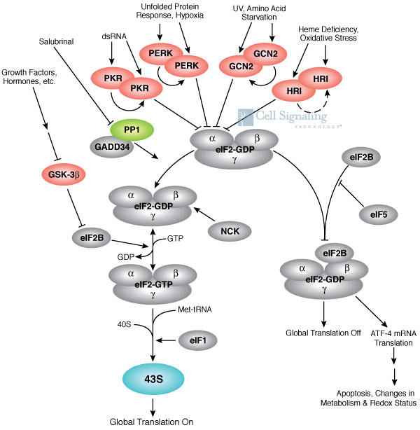
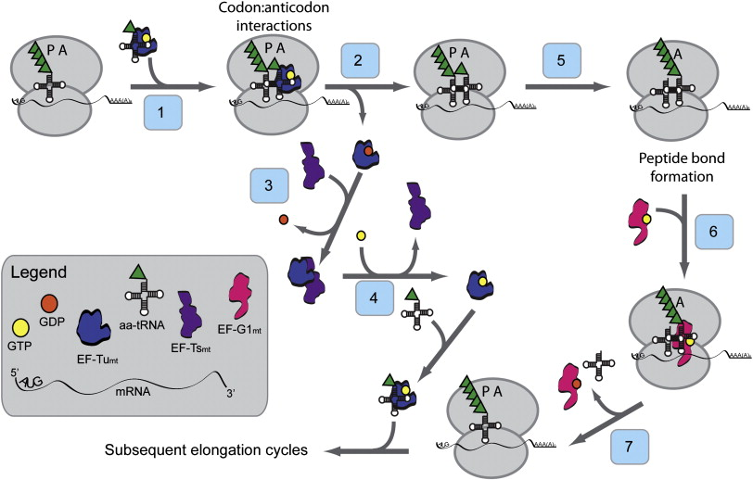
Translation: a very complicated process
Notes:
Translation is a complicated process.

Slide 12
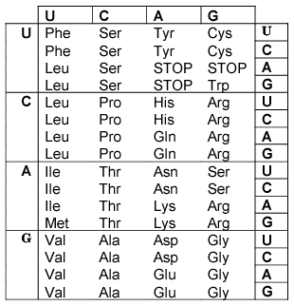
That reduces to simple rules…
Notes:
It all can be simplified down to very simple rules if all you care about is predicting the translation product for an open reading frame. However, don’t forget,

Slide 13
Translation: a very complicated process
Notes:
Translation is a complicated process. There is an orchestra of reactions taking place that involve the things you are accustomed to thinking about, including ribosomes and mRNAs. However, there is also a battery of enzymes for processing tRNAs, regulating the production of all these biomolecules, and producing all the precursor chemicals. Much of this complexity does not directly interact with most proteins you would put into the cell, unless you are adding genes that can interfere with translation. However, even for the average normal non-translation protein, the process of building that protein molecule has its own kinetics, its own transient microstates in terms of ribosome stalling and coincident folding of the protein. I won’t go further in discussing translation today since we’ll spend much more time on it later. However, for now, understand, it’s a complicated process.

Slide 14
Why do we need to know anything more about translation than the genetic code?

Slide 15
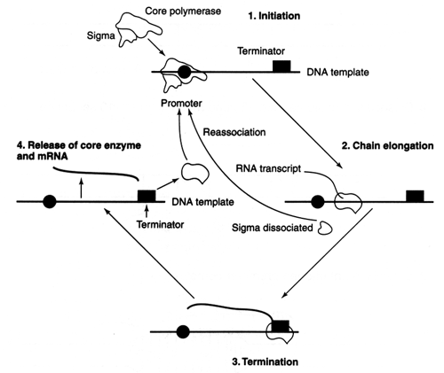
Transcription is complicated too
Notes:
The other major process that you will need to worry about is transcription. It it similarly an orchestra of metabolism and polymerization chemistry that also includes transcription factors and many microstates. Much of the complexity is in the early metabolic steps controlling production of monomer nucleotides, but the initiation process is also quite complex. It is even more complex in eukaryotes. We’ll deal with transcriptional models also in a later lecture. Just note for now that translation and transcription are two very complicated processes in a cell. It is currently unrealistic to model these processes at high refinement due to the large number of interactions and species, and the sparcity of kinetic data for describing most of these interactions. Instead, simpler phenomenalogical models are more commonly used to describe these processes.

Slide 16
Why do we need to know anything about transcription since all it does is make mRNA?

Slide 17
Compartments in Prokaryotes
Notes:
Localization processes exist in all cells and affect where your protein ends up after translation. Placing proteins in different parts of the cell is a common activity in genetic engineering.

Slide 18
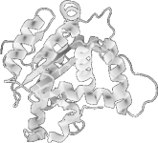
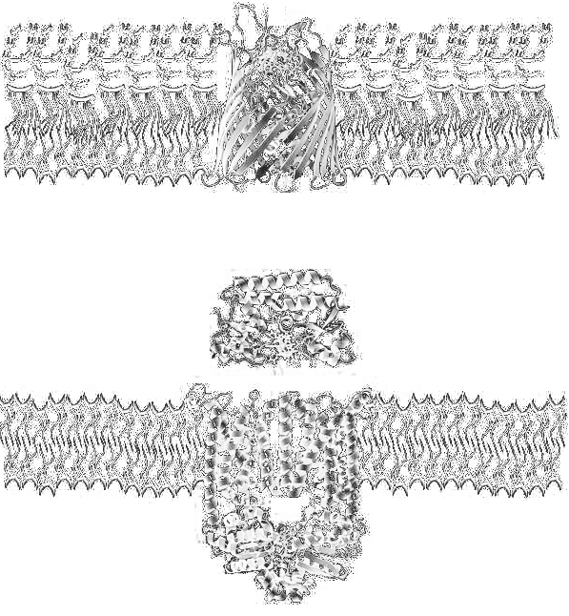
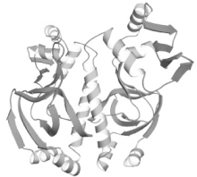
Localization in E. coli
Secreted
Outer Membrane
Periplasmic
Inner Membrane
Degradation
Cytoplasmic
Notes:
There are 5 readily distinguishable compartments in gram-negative bacteria such as E. coli defined by the presence of contiguous bilayer membranes that prevent free exchange of biomolecules. There is the cytoplasm in the innermost compartment where all the central dogma processes and most of metabolism takes place. Then there is the periplasm between the two membranes, and the extracellular environment accessible by secretion. The two membranes also present distinct compartments to the cell where proteins can be inserted.

Slide 19
Periplasm and Cytoplasm
Protein translation occurs in the cytoplasm
Two pathways exist for perplasmic localization: Tat and Sec
Sec secretion
Signal (pre) sequence, “Signal Sequence”, “Leader Sequence”
Pre-Pro indicates that the signal sequenced is cleaved after secretion
18-30 aa long, one or more basic aa near N-term, central 7aa or more hydrophobic core
protein is secreted unfolded, cotranslationally
Popular signals include pelB, ompT
Tat secretion
Signal Sequence: ((S/T)RRXFLK)
protein folds in cytoplasm, then transported
Notes:
All proteins start their life in the cytoplasm so the cytoplasm is the default location of a new protein in the absence of other targeting mechanisms
*click*
Two pathways exist for perplasmic localization: Tat and Sec
*click*
Sec secretion involves a signal sequence also called a leader sequence or pre sequence. Often a gene will employ a pre-pro sequence on the N-terminus which is cleaved after transport competes. Prepro sequences are typically 18-30 amino acids long and contain one or more basic residues near the N-terminus and a central 7 amino acid hydrophobic core. If a protein just contains a pre sequence, it will remain anchored to the membrane after translation. If it has a pre-pro sequence, it will be proteolytically cleaved off releasing the protein to the periplasm. During export, the protein is in an unfolded state and is often secreted coincident with translation. Popular ‘parts’ for pre-pro sequences that you’ll find in many common expression systems are the pelB and ompT leader sequences
*click*
The Tat secretion system similarly involves a signal sequence, but it doesn’t need to be on the N-terminus. It is the sequence S or T then RR (anything) FLK. During Tat secretion, the protein first folds in the cytoplasm and is subsequently transported. The system will not transport non-folded proteins which is a useful trick in various assays.

Slide 20
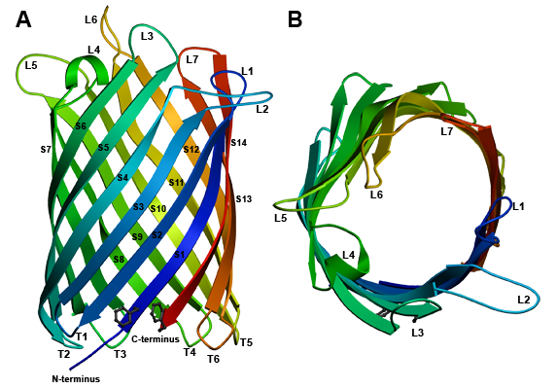
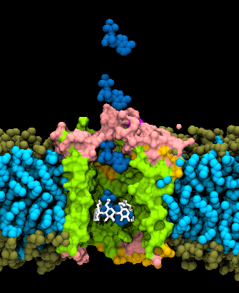
Outer Membrane Localization
Beta Barrel-type proteins
OmpA, OmpT, OmpG, LamB
Start with Sec secretion to periplasm
Spontaneously insert into outer membrane
Popular surface targeting systems: ompA, ice nucleation protein
For a long list classifiying cell-surface proteins:
http://www.tcdb.org/tcdb/index.php?tc=1.B.12.9.1
Notes:
Getting a protein to the outer membrane or extracellular environment is more challenging, but possible. Several of the E. coli systems have been examined extensively including OmpA, OmpT, OmpG, and LamB. The process starts with sec secretion to the peripasm, and then they spontaneously fold and insert themselves into the outer membrane. The most popular strategy for targeting a protein to the outer membrane in prokaryotes is to fuse the protein to another protein that already localizes there. Popular fusion-based targeting systems include ompA and a structurally dissimilar one called ice nucleation protein. If you want to learn more about what exists in this class, here is a nice list.

Slide 21
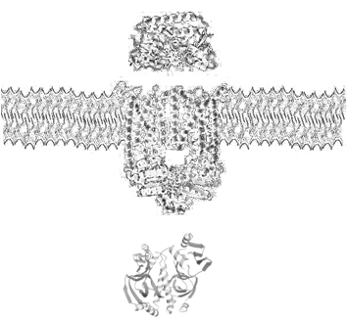
In gram positive bacteria (like B. subtilis)
Extracellular
Inner Membrane
Cytoplasmic
No second membrane present; but similar sec process
Prepro targeting results in extracellular secretion
Notes:
In a gram-positive bacterium, there is no second membrane, and thus there are only three vesicular compartments. The same basic set of proteins and localization signals that directed proteins to the periplasm in gram-negatives will target a protein for extracellular secretion in a gram-positive organism. Thus, secreting proteins is usually much easier to achieve in a gram positive rather than a gram negative bacterium. Industrially, commodiy proteins like porteases in detergent are usually produced in a gram-positive Bacillus strain. Various fungi are also good protein secretors.

Slide 22
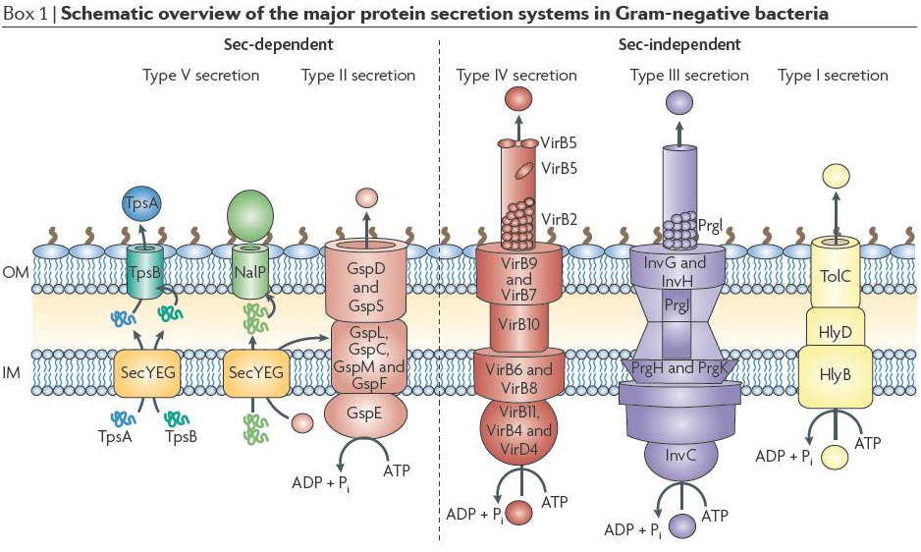
Modes of secretion in enterobacteria
PMID 19756009
Notes:
Targeting proteins for secretion is more challenging in gram negative bacteria. There are at least 6 distinguishable types of secretion systems that cluster based on sequence homology and consistent aspects of function. The type V and type II secretion systems, shown here at left, are sec-dependent. This means that the proteins being secreted will need to contain a pre-pro sequence on their N-terminus, and the first step of crossing the inner membrane involves the sec apparatus. Types I, III, and IV don’t employ sec forming a continguous conduit for secretion of protein from cytoplasm to the external environment.

Slide 23
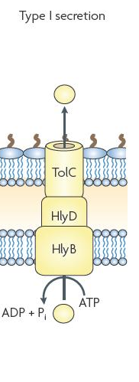
Type I secretion
Exemplified by the haemolysin secretion system from E. coli
Requires 3 transport proteins: an ATP-binding cassette (ABC) transporter or a proton-antiporter, an adaptor protein that bridges the inner membrane (IM) and outer membrane (OM), and an outer membrane pore
Substrate goes straight from cytoplasm to extracellular—no free periplasmic intermediate
Targeting by a relatively short tertiary structure signal specific to each system
PMID 2277639: last 60nt of hlyA can transport alkaline phosphatase to extracellular environment
Notes:
Type I systems are typified by the haemolysin secretion system from E. coli. Additing this functionality to E. coli requires 3 transport proteins: an ATP-binding ABC transporter, an adaptor protein that bridges both the inner outer membranes, and an outer membrane pore. Secretion of a protein through this apparatus doesn’t involve any periplasmic intermediate, the protein is shuttled straight through the channel. The targeting signal is a short 20 amino acid peptide on the C-terminus. If you’d like more detail, here is a reference that shows that the last 60 nucleotides of the HlyA are a sufficient targeting signal to transport alkaline phosphatase to the extracellular environment.

Slide 24
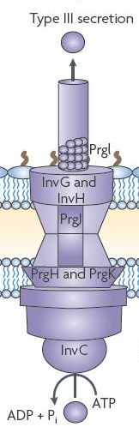
Type III secretion
Native to various strains of enterobacteria (E. coli, Salmonella, Shigella, Yersinia)
Also called injectisomes, often involve contact-dependent secretion into another cell
They are huge (like 20 proteins) and have lots of internal regulation
Evolutionarily related to flagella
Secretion signal appears to be tertiary structure-based, not simply a primary sequence tag
However, fusion of a secreted protein to another often will allow it to be pulled through as a passenger
Involves no free periplasmic intermediate
Notes:
Type III secretion systems are native to many clades bacteria and are usually associated with bacterium:host interactions. In addition directing proteins across the two inner membranes, type III systems usually have the ability to secrete protein across a host cell’s outer membrane. Those hosts include plant cells and mammalian cells, and different type III systems are specialized for the host cell’s surface structure. The genes are usually encoded as clusters and contain around 20 proteins with extensive internal regulation. They are both evolutionarily and functionally related to flagella, and in fact flagella can be repurposed for type III secretion in E. coli. The signal sequence does not appear to map onto a primary sequence. Instead, it is a property of the three-dimensional structure. However, you can often target another protein for secretion by fusion to a native effector that is normally secreted by the system. Like with Type I secretion, there is no periplasmic intermediate.

Slide 25
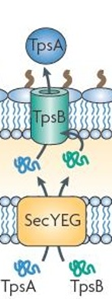
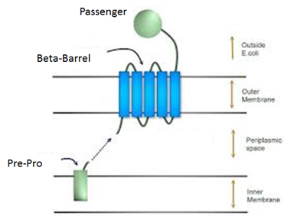
Type V secretion
Autotransporters
Typified by Ag43
Dedicated secretion system for a single protein
Begins with Sec secretion
Unfolded periplasmic intermediate spontaneously inserts itself and passenger into outer membrane
Can be surface display or secretion
Two-Partner Secretion
Two genes: the transporter and the passenger, both begin as unfolded periplasmic intermediates
Transporter spontaneously inserts then pulls the passenger through
Notes:
Type V secretion systems come in two types. Autotransporter proteins involve a single two-domain polypeptide. One of these domains is an outer-membrane barrel protein, and the other is a passenger protein. A well-studied example of this class is the Ag43 protein in E. coli if you’d like to learn more about this. The process begins with sec secretion to the periplasm as an unfolded protein. It then spontaneously inserts itself into the outer membrane and pulls the passenger domain through to the cell surface. Some autotransporter proteins remain this way while others undergo cleavage of the passenger to the secreted state. Both proteases and spontaneous processes can cause cleavage of extracellular domains from the membrane-bound barrel. So, sometimes autotransporters result in secretion, and other times they result in display.
*click*
Two-Partner secretion systems are very similar to autotransporters but each is composed of two genes. Like the autotransporters, TPS systems involve dedicated secretion proteins for singular proteins, but they are genetically encoded as two proteins instead of a fusion protein. TPP transport results in secretion of the passenger protein.

Slide 26
Type VI secretion
The newest type
Involves ~20 proteins like type III
I don’t know much about it
Notes:
I don’t have much to say about Type VI secretion. Microbiologists are still discovering new classes of transporters, and this is one of the newer ones. It involves a large cluster of proteins like type III secretion.

Slide 27
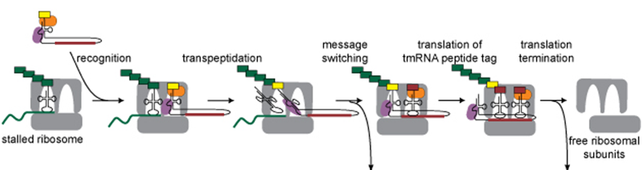
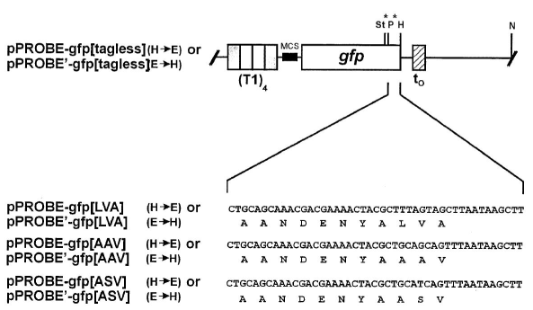
tmRNA-based degradation
PMID 11059491
Notes:
Another process that occurs in the prokaryotic cells is degradation. In eukaryotes, there is a large protein assembly called the degradosome that handles this recycling function, but it is far fewer components in prokaryotes and it has a more utilitarian function in the cell. When a ‘broken’ mRNA is translated, the ribosome will make protein until it reaches the end of the molecule at which point it will become stalled holding onto both the mRNA and the nascent peptide. These stalled complexes are rescued by a molecule called tmRNA which encodes a short peptide sequence AANDENLVA. This sequence targets the protein for degradation. This mechanism can be used to direct a protein for proteolysis in the cell. A commonly-used trick in synthetic biology is to use GFP[LVA] as a reporter gene for monitoring dynamic processes by microscopy. Proteins with this tag cycle in the cell instead of accumulating allowing more faithful observation of these processes.

Slide 28
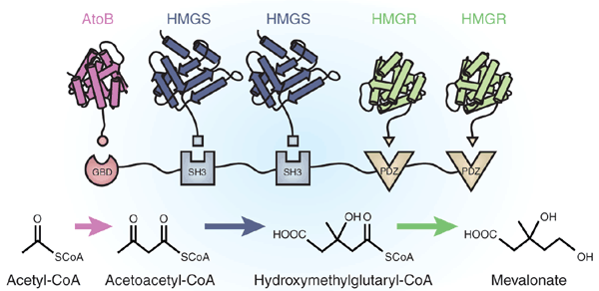
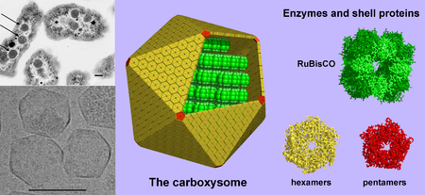
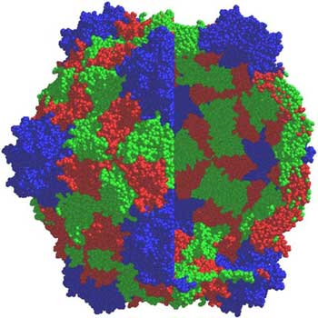
Compartmentalization
Cowpea mosaic virus
Qβ phage
Notes:
I’ve focused on compartments defined by lipid bilayers, but this is not the only type. Proteinaceous shells and aggregates of proteins similarly create local concentration effects and barriers to free-diffusion in the cell. Compartmentalization strategies based on fusion to protein scaffolds, RNA scaffolds, and DNA scaffolds are being investigated as strategies to more efficiently direct flux through a biosynthetic pathway. Additional strategies include protein shells such as the carboxysome or virus particles.

Slide 29
If I want to send my new aminoacyl-tRNA synthetase gene to the periplasm, how do I encode that?

Slide 30
If I want to display a cancer-associated epitope on the surface of E. coli, how would I do that?

Slide 31
Why might I put an AANDENALVA peptide on the C-terminus of a transcription factor?

Slide 32
Compartments in Eukaryotes
Notes:
There are many differences between prokaryotic and eukaryotic cells, but one of the most obvious is the presence of organelles.

Slide 33
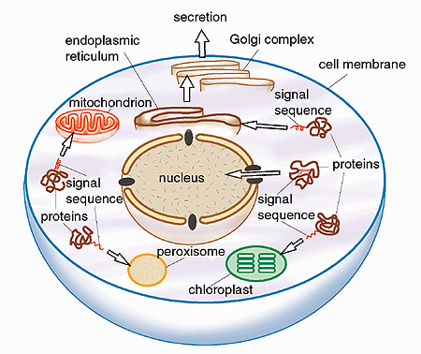
Localization in Eukaryotes
Notes:
Though there is only one membrane that surrounds the entire cytoplasm, there are many smaller lipid bilayers within the cell that obstruct the free-exchange of cellular metabolites. The degree to which a given comparment is permeable to a species is not simple, and there are many active transport processes associated with specific organelles. Thus, the degree to which a biomolecule is isolated within an organelle is not obvious.

Slide 34
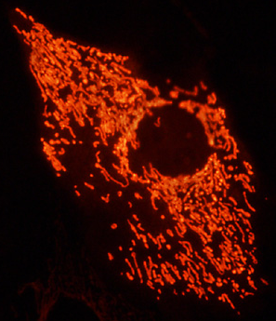
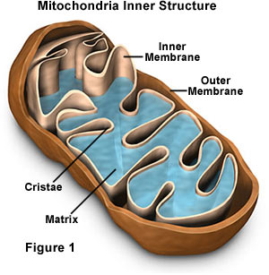
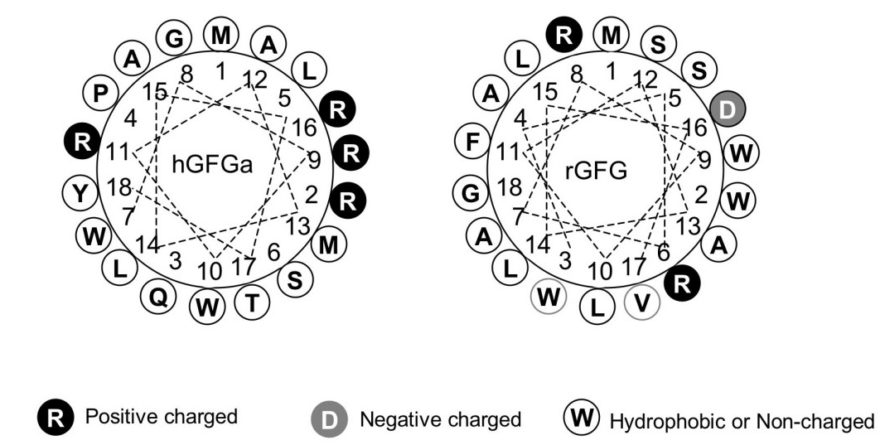
Mitochondria
Mitochondria are the source of ATP in eukaryotic cells
Have their own genome, but most proteins are nuclear genome-encoded
Targeting is posttranslational
mitochondrial targeting signal (MTS) has a sequence consisting of an alternating pattern with a few hydrophobic amino acids and a few plus-charged amino acids
Notes:
Mitochondria are the ATP-generated organelle of a eukaryote. The do encode their own genome and encode some of their own proteins. The degree to which the mitochondrial genes are encoded in the organelle versus in the nuclear genome differs between different organisms. In all cases, it is technically challenging to modify the DNA of a mitochondria, so protei The ns intended for mitochondria are usually sent there by use of localization signals. The mitochondrial targeting signal is a helix with a few hydrophobic amino acids and positively-change amino acids. This signal is recognized posttranslationally, so a protein will first exist as a cytoplasmic intermediate before being imported into the organelle.

Slide 35
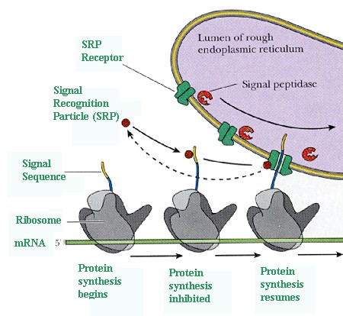
Endoplasmic Reticulum
Highly analogous to E. coli sec secretion
Secreted and surface displayed proteins
Integral membrane proteins
Glycosylated proteins
5-10 hydrophobic amino acids on the N-terminus, is cotranslational
Cleaved off after synthesis
COPII vesicles can package proteins from ER to Golgi for export
COPII signals are subtle, one is DXE in the C-terminus
Notes:
Secretion in eukaryotes is mediated by a compartment called the endoplasmic reticulum, or ER. The process of ER secretion is highly analogous both in sequence and effect as E. coli sec secretion. Both proteins that will be secreted to the external environment, as well as those being targeted to the membrane for surface-display go through the ER. The ER is the starting point for both integral and associated proteins, and most glycosylated proteins.
*click*
The signal for ER targetting is a 5-10 hydrophobic peptide on the N-terminus of the protein. As nascent protein chains emerge from the ribosome, as shown in this illustration, these peptides are bound by signal recognition particle, recruited to the ER. Translation then proceeds coincident with transport across the ER membrane. Unless it is a membrane protein, the newly-released peptide is cleaved off and is free within the organelle. Additional signals can be placed into a protein coding sequence to target it to other places in the cell. For example, a DXE motif in the C-terminus of the protein is the signal for targetting to the Golgi via COPII vesicles.

Slide 36
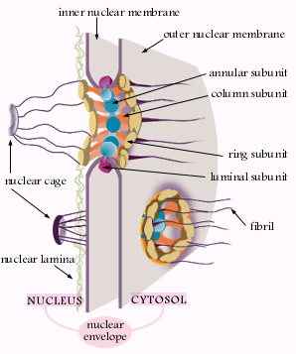
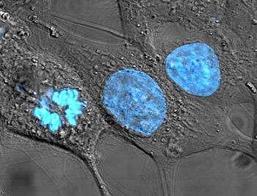
Nucleus
Nuclear localization signals are highly positively charged
PKKKRKV from SV40 large T antigen
KRPAATKKAGQAKKKK of nucleoplasmin
NLS are usually internal to a peptide sequence, but can be anywhere
Targeting is posttranslational
Nuclear localization is necessary for access to DNA (DNA modification proteins, transcription factors)
Notes:
The nucleus compartmentalizes the genomic DNA, and thereby necessarily the processes of replication and transcription. The protein components of the nucleus, however, must be translated in the cytoplasm like any other protein and then re-transported to the nucleus. The nuclear localization signals are highly positive charged peptides. The sequence PKKKRKV from the SV40 large T-antigen is one commonly-used sequence. Another from nucleoplasmin is a second option. The nuclear localization signal, or NLS, is usually internal to a peptide sequence rather than at the ends. It can be anywhere. Like with mitochondrial targeting, nuclear localization is post-translational. Nuclear localization is necessary for access to the genomic DNA. So, any engineered behaviors such as gene-delivery methods necessarily involve NLS signals.

Slide 37
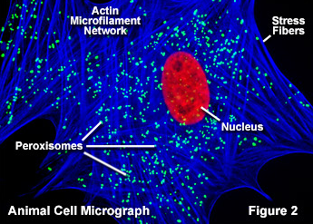
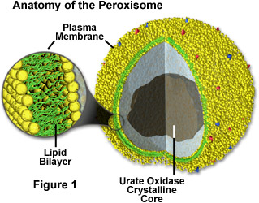
Peroxisome
Peroxisomes degrade long-chain fatty acids
Highly oxidizing environment
PTS1 signal is a C-terminal SKL peptide
PTS2 signal is an N-terminal (R/K)(L/V/I)X₅(H/Q)(L/A)
Notes:
Peroxisomes are organelles usually used to degrade long-chain fatty acids. It is a highly oxidizing environment. There are two types of signals that can transport a protein to the peroxisome. PTS1 signal is a C-terminal SKL peptide. PTS2 signal is an N-terminal sequence.

Slide 38
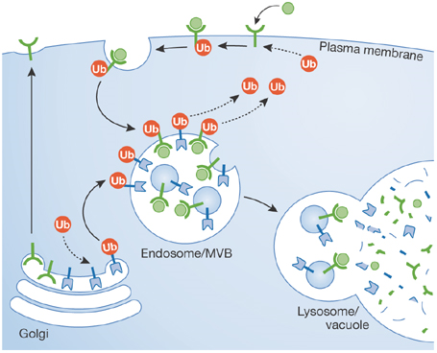
Lysosome
Lysosomes degrade things – intracellular bacteria/viruses, turnover of old organelles/proteins
Targeting involves a [D/E]XXXL[L/I]-type dileucine sorting signal, usually C-terminal
Is pH 4.5, so most proteins would be non-functional there
Used to make proteins degrade or make membrane proteins recycle
Notes:
Lysosomes degrade proteins and other debris. Targeting proteins to the lysosome involves a C-terminal signal called the dileucine sorting signal. Though you can send a protein to the lysosome, this usually result in its destruction. The pH is 4.5 making this chemically denaturing for most proteins. Thus, targeting proteins to the lysosome is usually a control strategy to intentionally remove a protein from the cell, or cause a protein to recycle in the cell.

Slide 39
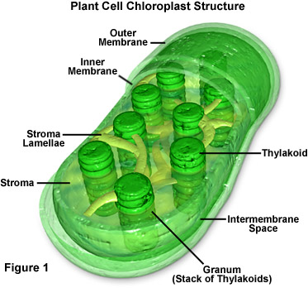
Chloroplasts
Photosynthetic centers of plants, single-celled eukaryotes like Volvox/Euglena/Chlamydomonas
Many proteins are encoded in its own genome
Also get plastids which are similar to chloroplasts
Chloroplast signal is rich in ser, thr, and small hydrophobic aas in the N-terminus, often requires a somewhat large targeting sequence (66 aa for GFP)
Notes:
Finally we have the chloroplasts and related plastids. These are the photosynthetic centers of plants and other single-celled eukaryotes such as volvox euglena, or chlamydomonas. The chloroplast is the organelle most similar to a prokaryotic cell with an extensive genome. Nevertheless, you still usually would genetically modify the nuclear genome rather than the chloroplast genome simply because it is easier. There is a large family of related organelles called plastids in plants. We’ll come back to these in a later chapter on plants. Other processes such as starch production happen in these organelles. This family of compartments are also the specialty workshops of plant cells where interesting natural products get produced.

Slide 40
I want to put nitrogen fixation genes into chloroplasts. How would I go about doing that?
Is that going to work?

Slide 41
Why might I want to target proteins to these various compartments:
Nucleus
Mitochondrion
Chloroplast
Plastid
Endoplasmic Reticulum

